Slide 1
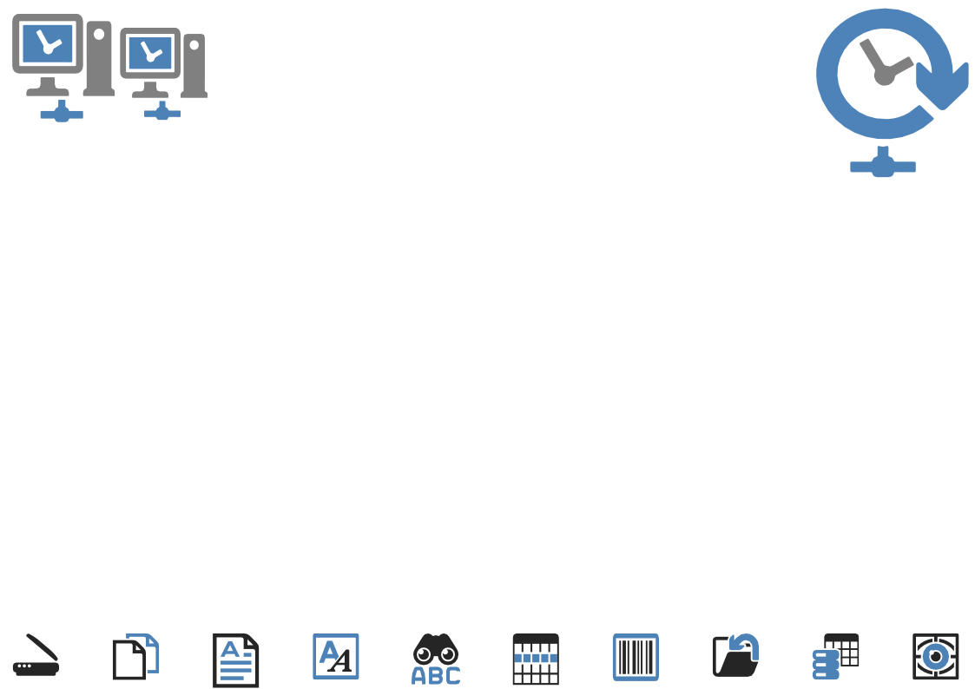
ChronoScan Profile
Established in 1995 in Madrid Spain
Expert imaging tools and libraries developers utilising;
Pixtools Scan/View/IP
Pegasus/Accusoft
Nuance (Omnipage)
NicomSoft, Softek
Atalasoft, PDF4NET, pdflibs,
We also work with open technologies like OpenCV, Tesseract, etc.
Our primary development platform is VC++, also we work in Java, NET, VB
Own intellectual property developed for;
IDR - Intelligent Document Recognition
Template matching
Zonal matching
Offset/rotation detection (2D/3D)
Fuzzy searches
Line item extraction and content decomposition
Intelligent Tag and data matching

Slide 2
Markets Served
Automotive
Consumer
Education
Engineering
Energy
Financial
Food and beverage
Government
Healthcare
Insurance
Legal
Manufacturing
Pharmaceutical
Retail
Technology
Telecoms
Transportation
Not-for-Profit

Slide 3
Applications
Account Payable Invoice Processing
Delivery Notes
Airway Bills
Human Resources
Scientific Documents
Utility Bill Analysis
Fraud Detection
Manufacturing Documents
Attendance Management
Forms and Surveys
Document Classification
Taxation Documents
Report Processing
Legal Documents

Slide 4
Partnerships
ChronoScan is represented by resellers of all sizes from SME’s to global corporations in Europe, Asia, Africa and North America.
Many of our resellers sell ChronoScan as a value added product to enhance their current products but equally many offer ChronoScan as a standalone product and all are fully trained by us to install and implement ChronoScan for a multitude of diverse applications.

Slide 5
ChronoScan Features
Intelligent document recognition
Zonal OCR
IntelliTags
OCR triggers
Table/line item dismount
Database integration
Barcode recognition 1D/2D
Hotfolders
Flexible document separation
Direct PDF text extraction
Visual Basic Scripting
Flexible input and export

Slide 6
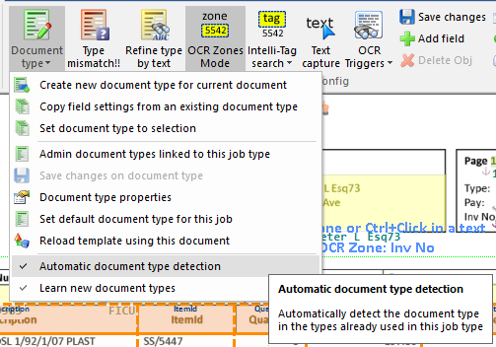
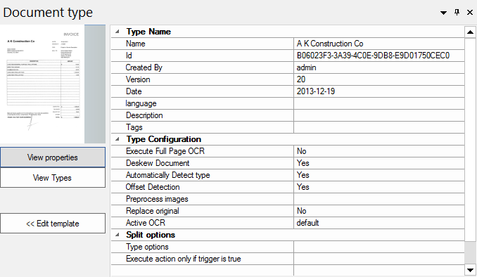
ChronoScan Features
IDR – Intelligent Document Recognition
ChronoScan uses a visual method for recognising/learning document types. Whenever a document is loaded into ChronoScan the IDR will check to see whether the document has been previously recognised/configured and if not a new type will be created.

Slide 7
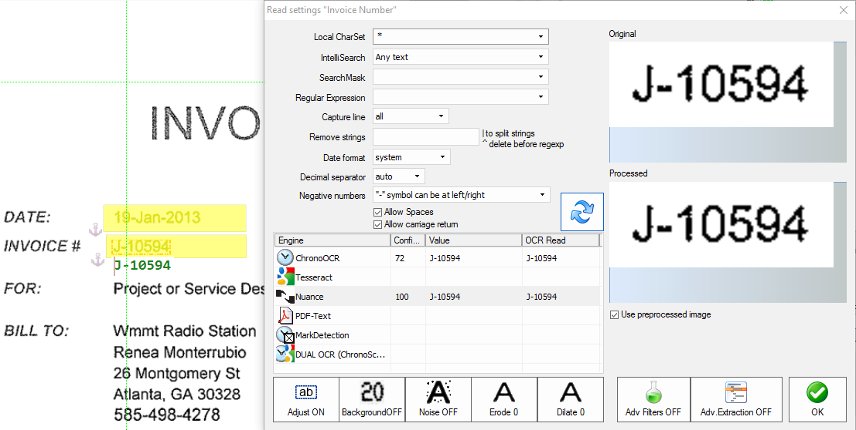
ChronoScan Features
Zonal Capture
ChronoScan provides a highly flexible mechanism for zonal capture for single and multi line zones.
Zonal capture is generally used where documents are of a structured or semi-structured nature but may also be used in combination with IntelliTags where the data may be of poor quality.

Slide 8
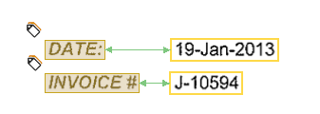
ChronoScan Features
IntelliTags
IntelliTags provide a mechanism for capturing data from unstructured documents where the same data to be extracted from different documents is not always found in the same position or even the same page.
IntelliTags locate a specific text/label i.e. “Invoice Number” or “Invoice Date” and when found ChronoScan will locate a specific data type in close proximity to the tag.

Slide 9
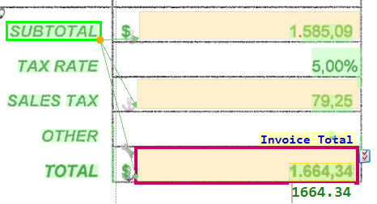
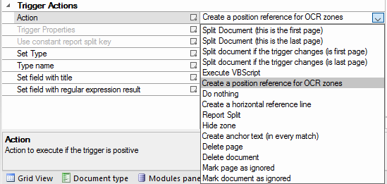
ChronoScan Features
OCR Triggers
OCR triggers provide a mechanism to recognise text (static or dynamic) in a specified area of a page (or whole page) and perform an action when the desired text is found.
Triggers can have several associated functions but some of the common functions are;
Locating anchor text to dynamically position a zone
Splitting a document
Changing/setting a document type

Slide 10
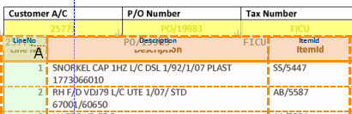
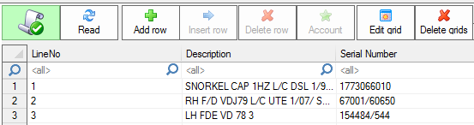
ChronoScan Features
Table/Line Item dismount
ChronoScan has the ability to perform data extraction from complex tables or line item data.
We have built numerous tools and functions that allow us to capture, extract and manipulate data from almost any type of table and can do so across multiple pages even where the table position changes.

Slide 11
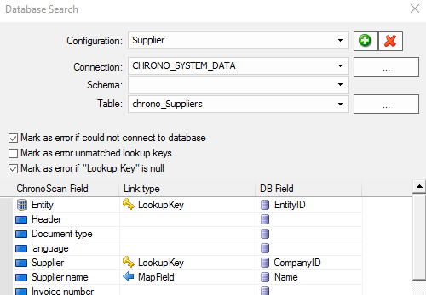
ChronoScan Features
Database Connectivity
ChronoScan provides a number of different ways to utilise databases such as;
Use of a database for verification
Bi directional lookup/data transfer during document processing
Databound lookup lists
Data export of extracted data

Slide 12
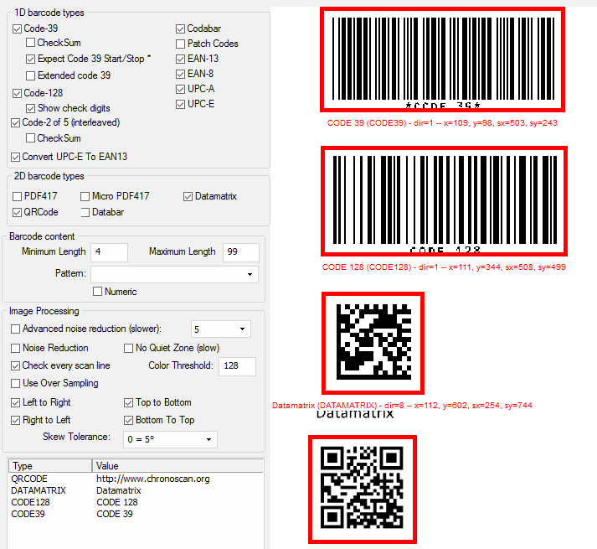
ChronoScan Features
Barcode Reading
ChronoScan is able to read most of the common 1D and 2D barcode symbologies
Multiple barcodes and symbologies per page/document supported
Reading can be filtered by pattern and/or area
Barcodes may be used for data capture and/or document splitting/sorting
Barcodes may also be used to trigger other action i.e. VB Script

Slide 13
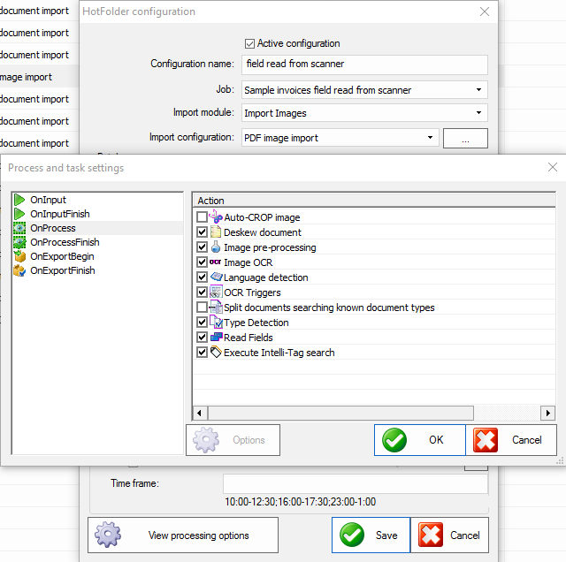
ChronoScan Features
HotFolders
HotFolders provide a mechanism to automate a ChronoScan workflow from import to export in a completely unattended process
HotFolders provide for device without TWAIN drivers such as some network scanners and MFD’s
HotFolder can receive files from another business process i.e. a PDF print spool
Multiple hotfolders can be defined running different applications
HotFolders may be scheduled to run at specific times

Slide 14
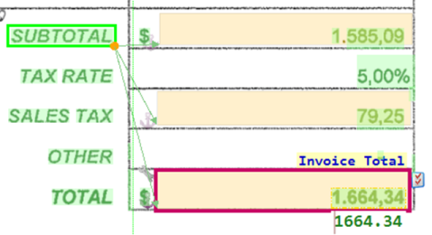

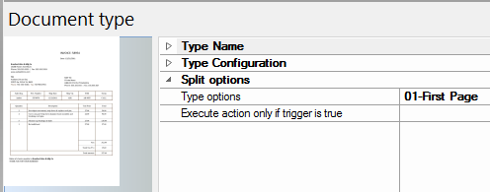
ChronoScan Features
Document Separation
ChronoScan provides multiple methods for splitting/separating documents, these methods include
OCR trigger split, this method splits when a specfic text string or pattern has be found on a specific page/area
Barcode split, this method splits the document when a barcode exists or matches a specific string/pattern
Document Type split, this method uses the known IDR types to split at either document or page level
VB Script split, this method allows the job developer to custom define conditions for a split to occur

Slide 15
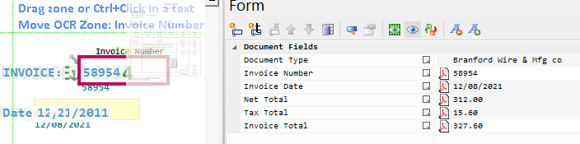
ChronoScan Features
PDF Text Extraction
ChronoScan uses document analysis to determine the nature of the data in a PDF file to determine whether the is native “born” digital , contains only image data or contains image data produced by a 3rd party OCR.
When ChronoScan detects that the document contains a native datastream it will extract this data directly to avoid having to ocr the document and potentially introducing errors. Another advantage in addition to the high accuracy is that as the datastream is being read directly the process is very much faster and therefore more efficient.
Often print applications will produce documents that contain both native text and image data where the native text has been embedded or overlaid onto a document, in this case ChronoScan can detect and only ocr the image data.

Slide 16
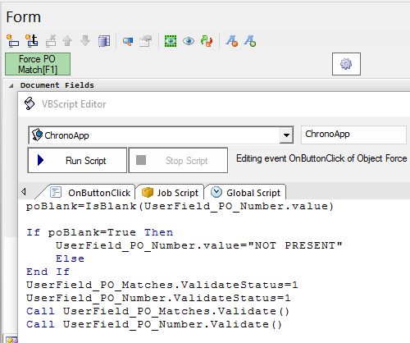
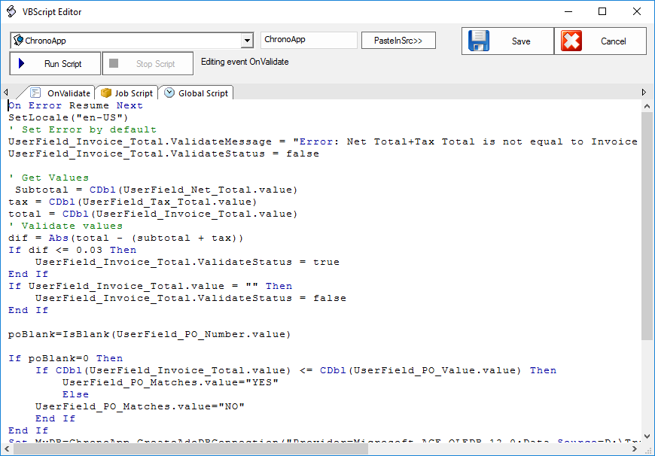
ChronoScan Features
VB Scripting
ChronoScan provides an extensive and robust scripting model with many built in events that provide an easy way for users to extend and customise the functionality of ChronoScan. Make ChronoScan do what you want, not almost what you want!

Slide 17
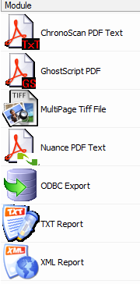
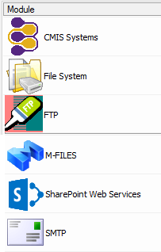
ChronoScan Features
Import/Export
ChronoScan provides a number of different input methods as follows;
Scan with any TWAIN enabled device, drag & drop, bulk import & HotFolder import
ChronoScan has input support for JPEG, TIFF, PDF (image, native and mixed), BMP and PNG file formats
ChronoScan is able to export to multiple formats including;
PDF and TIFF
Any ODBC compliant database
Fixed and variable length text
XML
Metadata and documents can also be exported to a number of destinations such as;
CMIS compliant systems i.e. Alfresco, Nuxeo etc.
Windows folders
FTP and SFTP
M-Files
MS SharePoint
SMTP

Slide 18
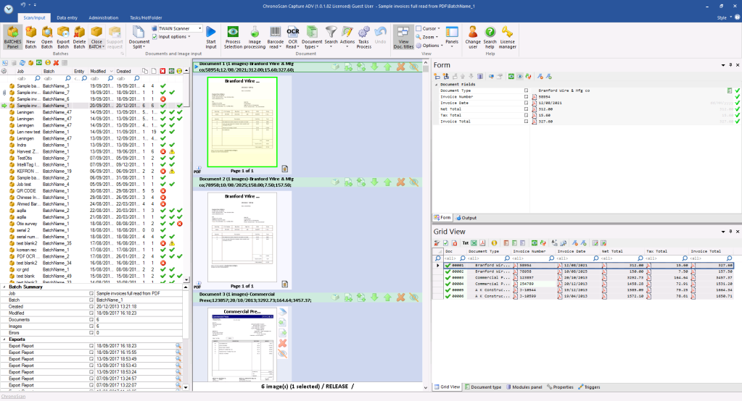
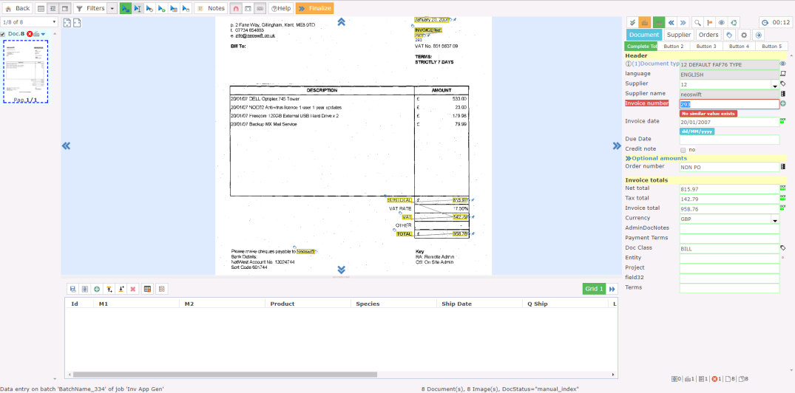
ChronoScan Features
Desktop or Enterprise
ChronoScan is available either as a single user desktop application or also a client/server multi-user, application with a thin client interface. Further details of the differences between ChronoScan Desktop and ChronoScan Enterprise can be found in our comparison matrix and within our brochures.

